Slide 1
PRINCE HALL GRAND CHAPTER
ORDER OF THE EASTERN STAR, RITE OF ADOPTION
HAWAII AND IT’S JURISDICTION INC.
2013 TREASURER’S WORKSHOP
Presented by
Bridget Terry
Grand Treasurer

Slide 2
PURPOSE
To provide the members of Prince Hall Chapter,
Order of the Eastern Star, Rite of Adoption,
Hawaii Jurisdiction Inc training that will prepare
them to successfully perform the duties as the
Treasurer for a subordinate Chapter.

Slide 3
DUTIES OF THE TREASURER
Receive all monies paid into the Chapter from the Secretary.
Gives Secretary receipt for all monies received.
Assure that all checks have three signatures.
Deposit the funds in a timely manner.
Keep Worthy Matron and Chapter abreast of financial status of Chapter.
Reconcile bank statements upon receipt.
Submit Annual financial report.
Keep all records, vouchers used to maintain all accounts.

Slide 4

Chapter Treasurer
The Treasurer of a Chapter is the proper custodian of all its money, securities, and other fiscal properties, and they cannot be taken from her control and placed under the control of others.
Notes:
Next Slide

Slide 5
RECEIVE MONEY FROM THE SECRETARY
Receive all monies paid into the Chapter from the Secretary.
  Gives Secretary receipt for all monies received.
  Deposit the funds in a timely manner.
  Count all money received by her.
  Earmark money in her ledger book.
  Keep ledger on all money received and
  disbursed.
The Treasurer must give the Secretary a receipt for all money received.

Slide 6

REQUIRED SIGNATURES ON A CHECK
  All checks written require three signatures.
    Worthy Matron
    Secretary
    Treasurer
    Alternate Associate Matron
  All signature cards must have at least four signatures.

Slide 7

MAKING DEPOSITS
All money must be deposited in the bank within 72 hours.
Treasurer must receive two deposit slips from the bank and must provide the Secretary with the duplicate deposit slip.
This deposit slip must be attached to the ledger page for the month the money was deposited.

Slide 8
CHAPTER FINANCIAL STATUS
Treasurer must provide the Chapter with a report of each previous month.
This report will show at a minimum the following:
  Beginning Balance
  Credits/Deposits/Bank fees
  Disbursements with check numbers
  Outstanding checks
  Checks cleared
  Voided Checks
  Earmark money
  Working balance
  Ending balance

Slide 9
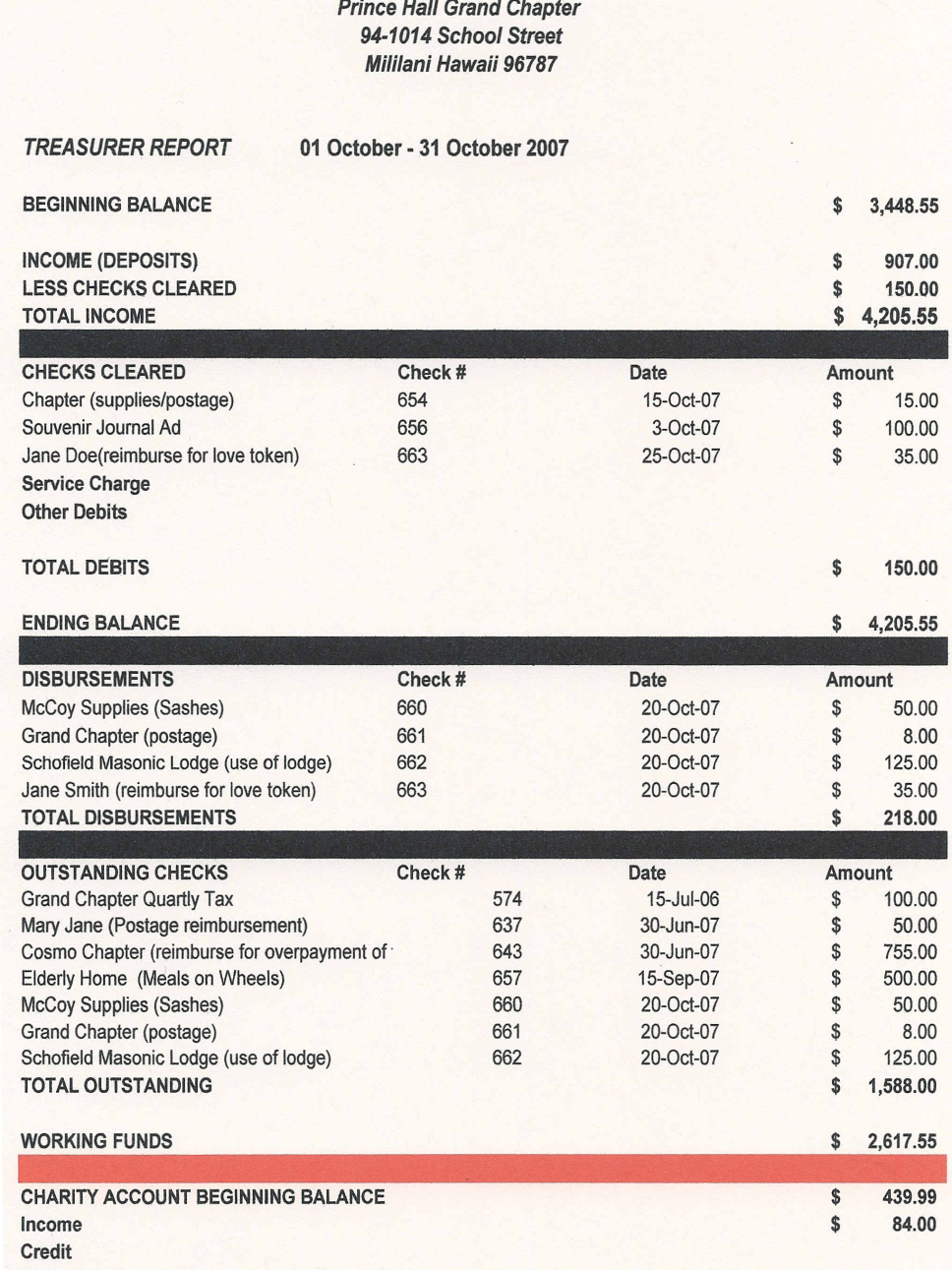
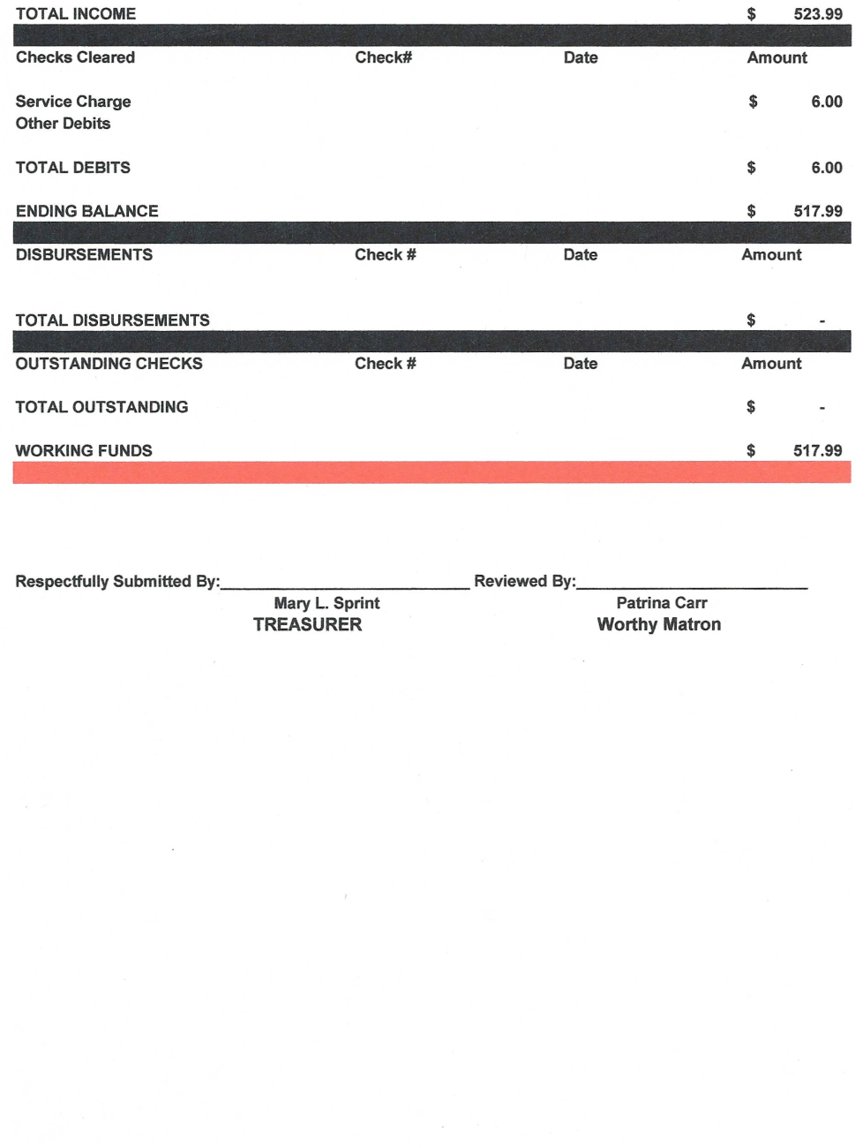
SAMPLE TREASURER REPORT

Slide 10
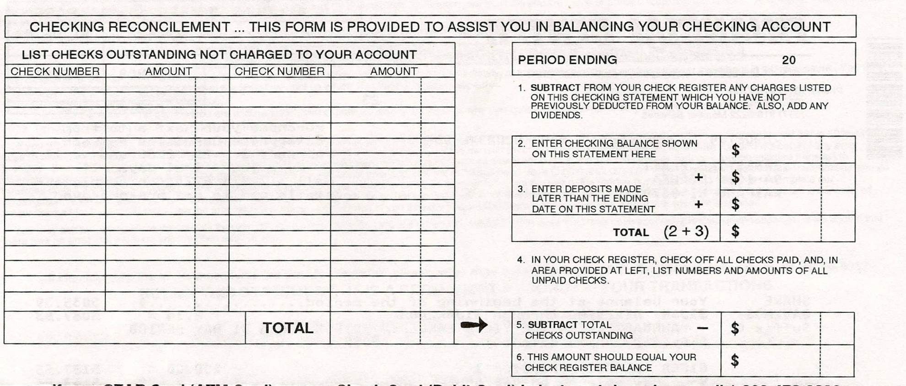
RECONCILE BANK STATEMENTS
September 08
101 100.00
102 50.00
103 100.00
1000.00
00
00
1000.00
250.00
250.00
750.00

Slide 11

MAINTAIN ALL RECORD BOOKS
Record information from check book to financial ledger.
Record information from bank statement to financial ledger.
Maintain record of funds balance.
Prepare and give treasurer report of previous statement at each meeting
Prepare and give quarterly and yearly financial report.

Slide 12

Check
#
800.00
Amount Brought Forward
Credit
Debit
Balance
4 Sep 08
Deposit
200.00
1000.00
4 Sep 08
PHGC of Hawaii
101
100.00
900.00
4 Sep 08
McCoy Supply Company
102
50.00
850.00
4 Sep 08
Cosmopolitan Chapter #1
103
100.00
750.00
5 Oct 08
Deposit
500.00
1250.00
5 Oct 08
Worthy Matron Jane Doe
104
200.00
1050.00
5 Oct 08
VOID
105
1050.00
5 Oct 08
Bank Fee
6.00
1044.00

Slide 13
PREPARE THE CHAPTER’S REPORTS
Prepare the Chapter’s quarterly reports and submit to the Grand Secretary.
Prepare and send annual year end financial report to Grand Secretary.
Prepare and give your report at the Annual meeting.

Slide 14
TREASURER BOOKS
Receipt Book
Financial Ledger Book
Check Book
Treasurer Reports
Copies of checks written or cleared checks
Warrants signed by the Worthy Matron and Secretary.
Deposit slips from bank.

Slide 15
What is IRS Form 990-N?
Form 990-N, also called the E-postcard, is a short electronic notice that most small, tax-exempt organizations (such as 501(c)3s) have to file with the IRS, starting in 2008 for activities from January 1, 2007 onward.
Form 990-N is a way of ensuring transparency among small non-profits.

Slide 16
Who must file Form 990-N?
If your nonprofit organization:
Is Tax-exempt
Has gross receipts of $25,000 or less
Is not required to file another IRS form such as Form 990, Form 990-EZ, or Form 990-PF
Is not part of a group return
Then the organization must file the e-postcard with the IRS.
Your organization may choose to submit a completed IRS Form
990 or Form 990-EZ instead. However, the Form 990-N is
much simpler and quicker to fill out.

Slide 17
What is required in Form 990-N?
The IRS’s e-postcard is short and simple. Here is what you must
provide:
Organization’s name
Any other names your organization uses
Organization’s mailing address
Organization’s website address (if applicable)
Organization’s employer identification number (EIN)
Name and address of a principal officer of your organization
Organization’s annual tax period
A statement that your organization’s annual gross receipts are still normally $25,000 or less
If applicable, indicate if your organization is going out of business

Slide 18
Why is Form 990-N necessary?
Before, most small non-profits (grossing less than $25,000 a year) did not have to file anything with the IRS.
However, the Pension Protection Act of 2006 (PPA) changed that. Requiring that you file annually ensures that the IRS and potential donors can access up-to-date information on your organization.

Slide 19
How do I file Form 990-N?
The IRS requires that the e-postcard be filed electronically. There is no paper form.
You must be able to access the internet, but no software or download is required.
If your non-profit does not have a computer, you will be able to fill out Form 990-N using a computer at a public library.

Slide 20
When is Form 990-N due?
Form 990-N must be filed every year; however there is no one due date for filing the e-postcard.
Instead, you must file “by the 15th day of the 5th month after" your non-profits’ fiscal year ends.
For instance, if your fiscal year is the same as the calendar year (ie, ending on December 31st), your organization does not need to file the e-postcard until May 15.

Slide 21
What happens if I don’t file Form 990-N?
If your non-profit fails to file the e-postcard for three consecutive years, the IRS will revoke the organization’s tax-exempt status.
Form 990-N is meant to be quick and easy to file, however, so there should be no reason for this to happen.

Slide 22
IRS FORM 990-N E-postcard
Before attempting to complete the e-postcard, you
will need the following:
Taxpayer ID number on file with the IRS
Legal Name: Chapter name and number
The IRS Form 990-N is to be filed electronically via the Urban Institute website contracted by the IRS.

Slide 23
STEPS TO FILING E-POSTCARD
The web address is http://epostcard.form990.org
Click on Postcard: File your electronic IRS FORM 990 N
Step 1 Register as a New User
To file form 990-N (e-Postcard), you must register
Step 2 Your Log on ID is your Federal Tax ID number
Step 3 Create password (use something that is not personal, however something you will remember)
Verify password
Fill in appropriate fields
First name
Last name
Email address
Verify email address
Telephone number

Slide 24
STEPS TO FILING E-POSTCARD cont.
Click on link to verify activate login ID success
Next page – Tells you if you were successful in creating your log in
Next page will be either one of the tow below listed functions:
According to the IRS records, your tax year has not ended; you cannot file the e-postcard until your tax year has ended.
Create your Form 990 N
Once you have login ID, you can access the system and create your e-postcard.
Click the link to begin the process
When you are done, print a copy of the form
Submit your Form 990 N e-postcard
Once you complete your e-postcard, click on submit filing to IRS button
You will receive a confirmation notification in your email
Print and mail the confirmation to the Grand Treasurer

Slide 25
AUDIT REPORTS
The Chapters records and financial accounts must be examined and inspected at least semi annually.
An adjustment or correction of accounts.
An examined and verified account.

Slide 26
TREASURER BOOKS
Check Book
Copies of Checks or Cleared Checks
Ledger Book
Receipt Book
Deposit Slips
Bank Statements
Treasurer Reports
Warrants

Slide 27
QUESTIONS

