Slide 1
PRINCE HALL GRAND CHAPTER
ORDER OF THE EASTERN STAR, RITE OF ADOPTION
HAWAII AND IT’S JURISDICTION INC.
2013 SECRETARY’S WORKSHOP
Presented by
Ernestine Pratt
Grand Secretary
Notes:
Good morning my name is Sister ______________, I am the Grand Sectary of Prince Hall Grand Chapter of Hawaii.
Today I will provide you with information on the duties of the Chapter Secretary.
The Secretary has one of the most important jobs in the Chapter, so its important that she is proficient in her duties. But remember that it takes the entire body to make this organization work.
Next Slide

Slide 2
PURPOSE
To provide the members of Prince Hall Chapter,
Order of the Eastern Star, Rite of Adoption,
Hawaii Jurisdiction Inc training that will prepare
them to successfully perform the duties as the
Secretary for a subordinate Chapter.

Slide 3
OBJECTIVES
Record the minutes of the Chapter
Receive all correspondence and reports
Prepare and mail all correspondence
Collect all funds of the Chapter
Disbursements
Maintain all records books
Order and maintain all supplies
Notes:
Today we will cover the objectives that are listed on the slides. At the end of this training you will all be able to perform the duties of the Secretary.
Next slide

Slide 4
OBJECTIVES cont.
Receive and process membership applications and maintain status of applications
Maintain the historical and financial account of members
On the death of a member, prepare Chapter resolution and application for beneficiary
Prepare the Chapter’s annual reports
Notes:
Next Slide

Slide 5
Chapter Secretary
The Secretary is the custodian of the
Chapter records and seal of the Chapter.
She performs the secretarial, clerical and
administrative functions of the Chapter.
Notes:
Next Slide

Slide 6

RECORD THE MINUTES OF THE CHAPTER
Record minutes on note pad or the agenda that will be provided by the Worthy Matron. State type of meeting, time, actions taken, communication received, receipts and disbursements.
Transfer from pad or agenda to bound minute book
Read at next stated meeting. If corrections are needed on the minutes read from the previous meetings, state the corrections needed in your current minutes.
Make sure minutes are signed by the Secretary and the Worthy Matron.
Notes:
If possible the Worthy Matron should appoint an Assistant Secretary to assist with taking the minutes. This will allow the Secretary time to focus on all the other duties that you see on the screen.
The Assistant Secretary should be taking the minutes on a pad or an agenda provided by the Worthy Matron.
Once the meeting is over she can transfer the information to a bound minute book.
The minutes should be read at the next meeting and all corrections to those minutes should be made on your current minutes.
The minutes must be signed by the Secretary and the Worthy Matron, the seal is not necessary.
Next Slide

Slide 7

RECEIVE ALL CORRESPONDENCE AND REPORTS
Receive correspondence and prior to the meeting inform the Worthy Matron of correspondence received.
Read correspondence at meeting.
File all correspondence and reports after each meeting.
Notes:
All official correspondence from the Grand Chapter should be read in it’s entirety and annotated in the minutes.
Next Slide

Slide 8
PREPARE AND MAIL CORRESPONDENCE
Make sure all outgoing correspondence has the Worthy Matron and Secretary’s signature with the Chapter Seal.
Prepare and mail in a timely manner all delinquent notices, assessment notices, etc.
Prepare and mail any special notices pertaining to special meetings, changes in stated meetings, etc.
Notes:
When ever you send out correspondence from the Chapter it must have the signature of the Worthy Matron, Secretary and the Chapter Seal.
Once a member is three months in arrears the Secretary must send a notice to the member informing them of such. This notice must be mailed to the member on the first day of the fourth month of them becoming delinquent informing them of their indebtedness. Failure to pay within 30 days another notice will be sent. If the member fail to pay a third and final notice will be sent and if the member again fail to pay the will be suspended at the next regular schedule meeting. Three notices must be sent to the member before they can be suspended. A vote of two-thirds of members present at a stated Chapter meeting shall be necessary to suspend a member for non-payment of dues.
If the Worthy Matron calls for a special meeting or changes a meeting the Secretary must notify the members in writing within 10 days and request a dispensation from the Grand Worthy Matron.
The Secretary must keep a copy of all correspondence sent.
Next Slide

Slide 9
COLLECT ALL FUNDS OF THE CHAPTER
The Secretary receives all monies of the Chapter and reports the same to the treasurer for deposit.
Record all funds in receipt book, giving original to payer.
Count all money received and give all funds collected to the Treasurer.
Ensure that the Treasurer provide her with a receipt of the money turned over to her.
Notes:
It’s very important that the Secretary provide a receipt to everyone that pays money into the Chapter, this includes non members.
All money collected by her must be given to the Treasurer and the Treasurer must give the Secretary a receipt.
Next Slide

Slide 10
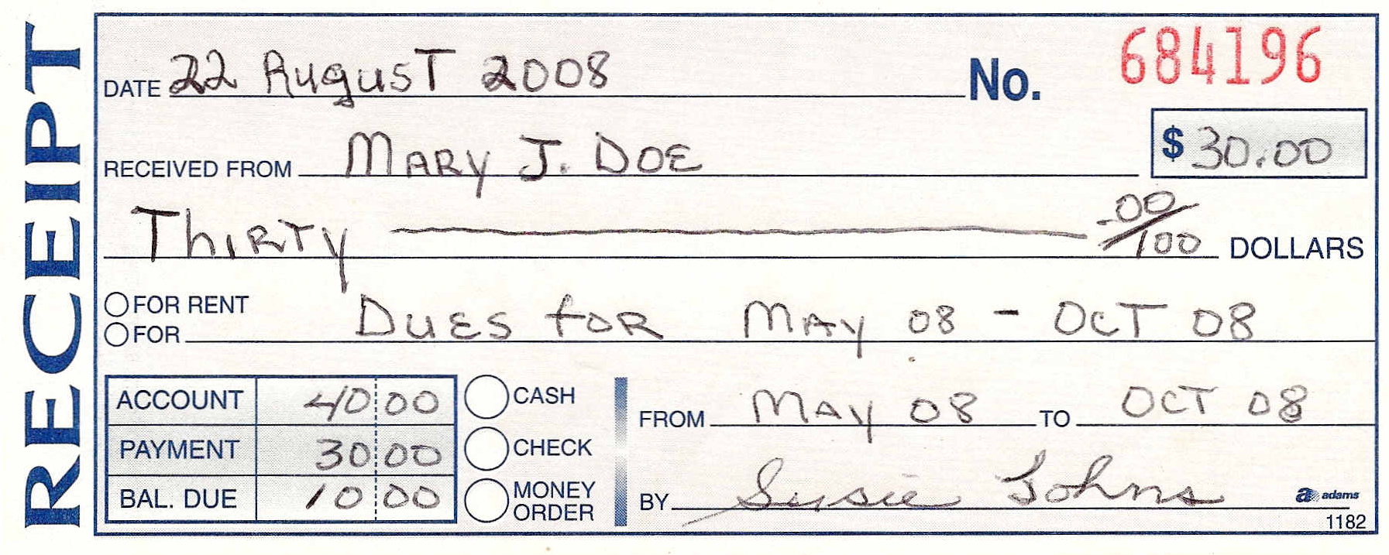
CHAPTER RECEIPT SAMPLE
Notes:
This is a sample of a receipt that was received from a member that paid for 6 months dues. The Secretary must ensure that all information is on the receipt.
Instructor will go over the receipt with audience.
Next Slide

Slide 11

DISBURSEMENTS
The Secretary shall ensure the proper approval of
disbursements of funds by issuing warrants to the
Treasurer on all authorized payments.
Prepare and sign warrants.
The warrant number must match the check number.
Obtain Worthy Matron’s signature on warrant.
Submit warrant to Treasurer.
Notes:
The only time the Treasurer can write checks is when she receive a warrant from the Secretary. The warrant must be complete and have the signature of the Secretary and Worthy Matron. The warrant number must match the check number.
If the Treasurer voids a check, she must inform the Secretary that she voided the check and provide her with the warrant number so that the Secretary can void the warrant stub.
All disbursements must be read, the amounts and what the warrant was written for, along with the warrant number must be in the Financial Report and read at the end of the meeting to be made a part of the record.
Next Slide

Slide 12
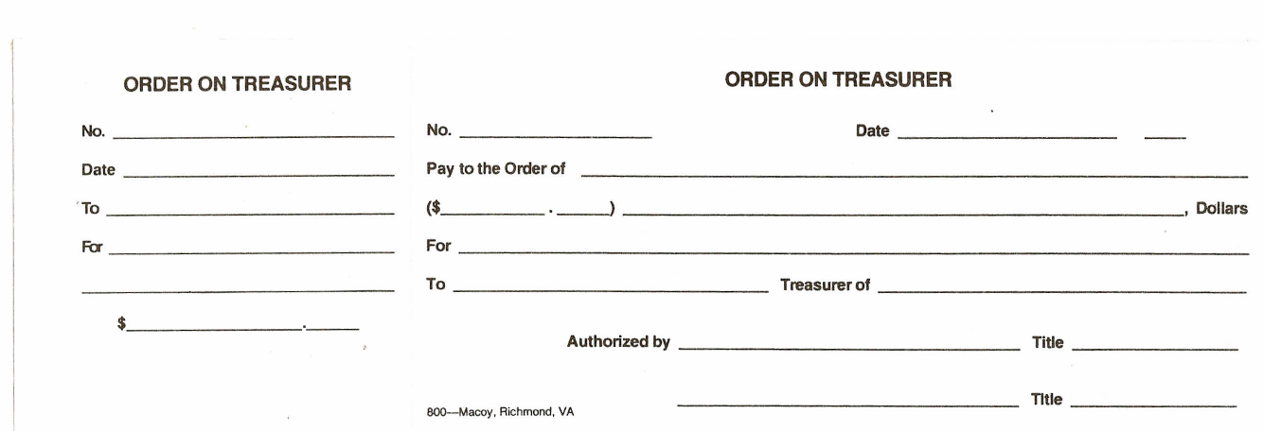
SAMPLE WARRANT
101
101
Sept., 12 08
Sept., 12 2008
PHGC of Hawaii
PHGC of Hawaii
100 00
One Hundred ------------------------------
4th Quarter
Per Capita Taxes
4th Quarter Per Capita Taxes
Kathy Smith
New Hope Chapter #2
100 00
Mary Doe
WM
Jane White
Secretary
The Secretary can keep a running balance in the warrant book (if the type of warrant form used, makes provision for entry). However, not all warrant forms provides for such an entry and such an entry is not mandatory.
Notes:
Instructor will explain the warrant.
Next Slide

Slide 13

MAINTAIN ALL RECORD BOOKS
Record information from receipt book to financial ledger.
Record information from warrant book to financial ledger.
Maintain record of funds balance.
Prepare and give financial report at the end of meeting.
Prepare and give quarterly and yearly financial report.
Notes:
Every Secretary must have a financial ledger book and keep a running balance of all money received. This ledger will be in a bond book.
At the end of the meeting she must give a report on all money that was received, she must state the amount, who the money was from and what the money was received for. She must also give a total of money received that day.
Next Slide

Slide 14
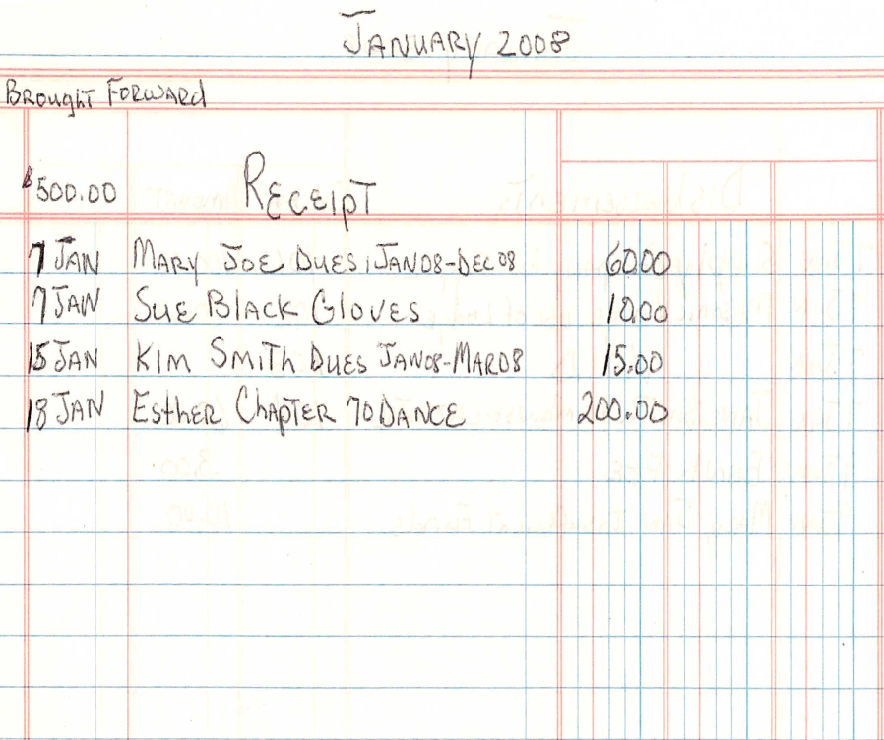
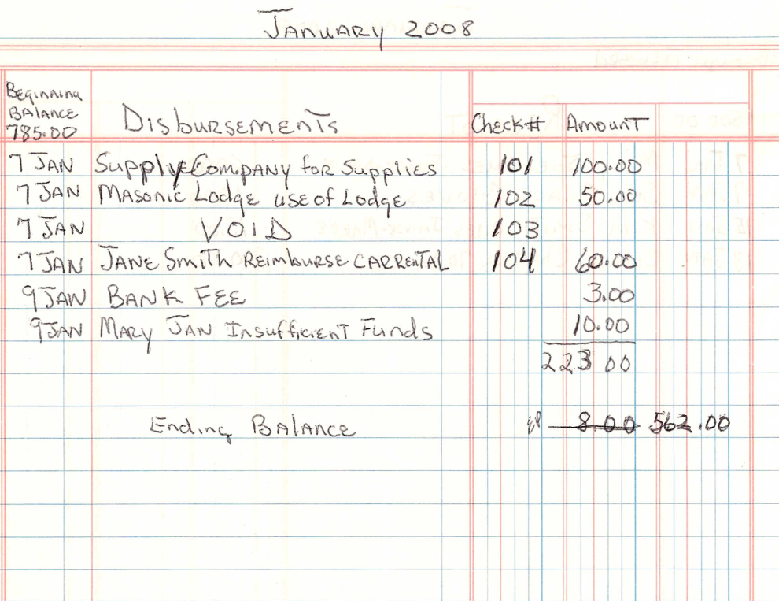
FINANCIAL LEDGER
Do not total ledger page until the bank statement is received for that month
and the Treasurer provide you with all bank fees that may apply.
The Secretary may receive money in the mail. It should be noted in the ledger and
Turned over to the Treasurer, the Treasurer must give you a receipt.
Notes:
When money is received out side of the meeting it must be reported at the next meeting in the minutes.
If the Secretary receive money in the mail, she must also mail that individual a receipt as soon as she receives the money.

Slide 15

ORDER AND MAINTAIN ALL SUPPLIES
Forms
Due Cards
Badges
Rituals
Etc.
Notes:
Another responsibility that she has is ordering supplies. She must keep an inventory of all supplies that she has on hand and place her order before she runs out of stock.
The Secretary can replenish her supplies from the working funds provided by the chapter. She must keep all receipts and provide with her report.
Next Slide

Slide 16
RECEIVE AND PROCESS MEMBERSHIP APPLICATIONS AND MAINTAIN STATUS OF APPLICATIONS
Check and assure application is complete.
Read Petitions.
Send receipt to applicant.
Notify applicant about results of ballot.
If application is elected, notify as to time, place, attire. If applicant is rejected, return monies submitted, inform if can be resubmitted. Send a letter to applicant of results.
Prepare membership ledger for new members and put member on roster.
Notes:
The Secretary and the Worthy must ensure the Petitions are filled out correct. She must send a copy to the Grand Chapter within ten days after the initiation.
All petitioners must receive a letter stating if they were accepted or rejected. If the petitioner was accepted the Secretary must inform the petitioner of the place, time, and attire.
If the petitioner is rejected she must return the petitioner’s money at the time they are rejected and inform them if and when they can resubmit their petition.
The Secretary must provide to the Grand Secretary the name of petitioners that were rejected with 5 days.
The rejected petitioner may petition the Chapter for membership after 3 months.
Next Slide

Slide 17
ITEMS FOR NEW MEMBERS
Obtain the new member’s signature on the Chapter’s By-Laws.
Provide the new member with the following:
Chapter’s By-Laws
Mentor
Dues Card
Member Certificate
Ritual
Chapter Roster
Information on meeting dates and dress
Notes:
Once the candidate has been initiated please provide them with the following items you see listed on the slide.
It’s very important that the Worthy Matron assigned a mentor to the new member. We must make them feel welcome. Remember this is the time that they are seeking some knowledge.
Recommend that the Chapter create a booklet containing the Chapter By-Laws with pages for new members to sign and, ensure the new member print their name.
Next Slide

Slide 18

MAINTAIN HISTORICAL AND FINANCIAL ACCOUNT OF MEMBERS
Transfer information from petitions, demits, etc., to membership ledger sheets.
Maintain up-to-date information on personal data. (Current address, telephone, email, etc.)
Record dues information on ledger sheet. Issue dues card.
Notify members of suspension, etc.
Notes:
You must keep the membership ledger update, this is the only way you can track what status the member is in.
Next Slide

Slide 19
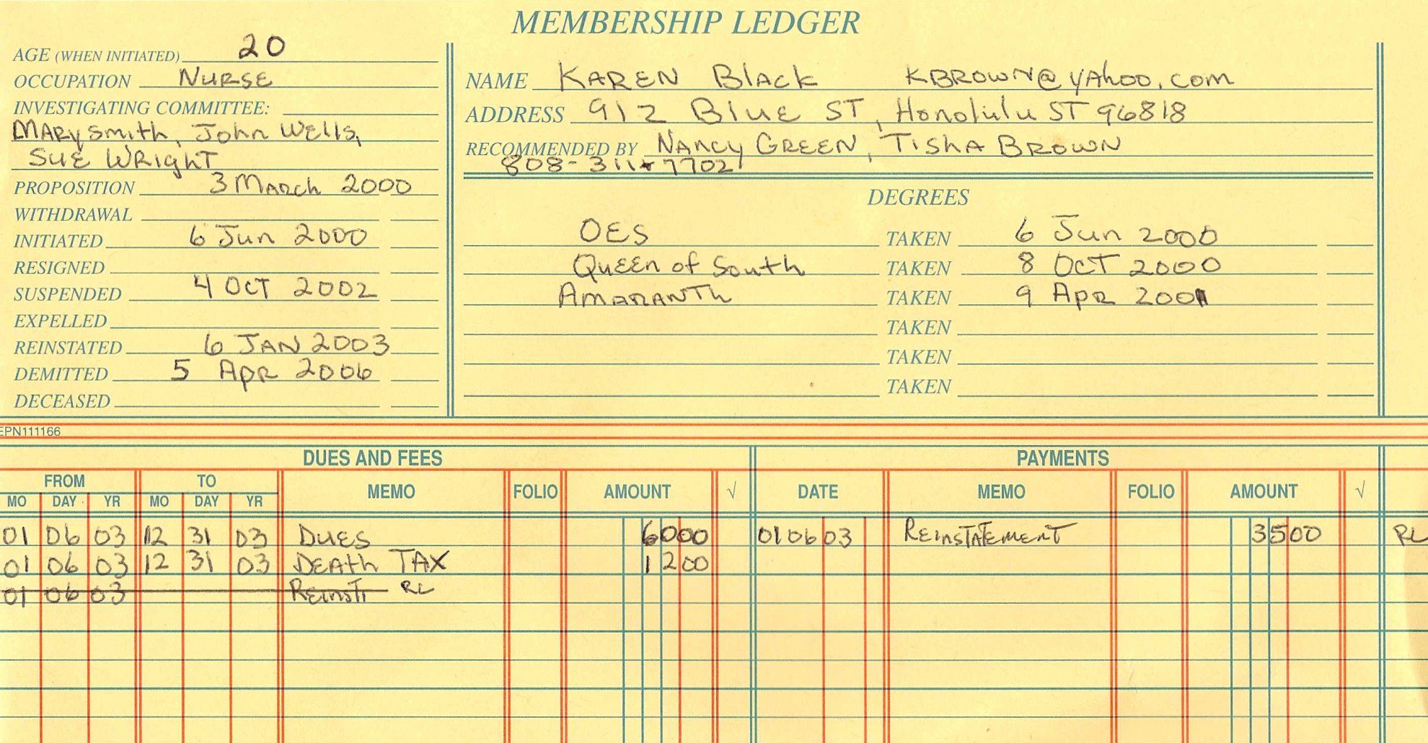
MEMBER LEDGER
Notes:
The Secretary must keep a register of all members of the Chapter and the financial standing of each member. All books of record are the property of the Chapter.

Slide 20
DEATH OF A MEMBER
Prepare Chapter’s resolution.
Order flowers, etc.
Read resolution during memorial service.
Prepare application for beneficiary and submit application to the Grand Secretary.
Notes:
All beneficiary information must be updated at least once a year or if a change occurs. If a member dies the Secretary must report this to the Grand Secretary. The chapter is responsible for preparing a resolution.
An official death certificate must be submitted to the Grand Chapter in order for the death benefits to be paid.
Next Slide

Slide 21
PREPARE THE CHAPTER’S REPORTS
Prepare the Chapter’s quarterly reports and submit to the Grand Secretary.
Prepare and send annual year end financial report to Grand Secretary.
Prepare and give your report at the Annual meeting.
Prepare and submit, Election Report.
Notes:
All reports must reach the Grand Secretary in a timely manner along with all fees. The Secretary should prepare all quarterly reports and annual returns . Quarterly reports are due to the Grand Secretary by the 15th day of April, July, October, and January and the Annual Returns are due on or before 30 April of each year.
The Secretary must give a report to the Chapter at the Annual meeting in December.
The Election Report must be submitted to the Grand Secretary within 10 days of the election. This report encludes a list of all officers and their addresses, telephone numbers and email addresses.
Next Slide

Slide 22
SECRETARY’S BOOKS
Minutes Record Book
Receipt Book
Warrant Book
Financial Record Book
Membership Historical Record Book
Membership Roll Book
Membership Sign-In Book
The Secretary should also have in her keep
Grand Chapter Constitution & By-Laws and Subordinate Chapter By-Laws
Book of Instructions
Audit Book
Chapter Seal
Updated Chapter Roster
The record books listed above should be labeled for identification
Notes:
All Chapters must have the books listed on the slide and these books will be inspected by the Grand Chapter at any given moment.
Next Slide

Slide 23
HELPFUL HINTS - REMINDERS
It is imperative that the Secretary and Treasurer work together.
The Secretary should receive all monies coming into the Chapter.
The Treasurer should immediately receipt monies to the Secretary.
The Worthy Matron must sign all warrants.
The Secretary’s minutes must be in a bound book.
Notes:
Instructor will read all helpful hints.

Slide 24
HELPFUL HINTS – REMINDERS cont.
No checks should be written without a warrant. All warrants and checks should be filled in completely. Warrant numbers and check numbers should match.
The Treasurer must notify the Secretary of all bank charges, return checks and fees, new check order fees, and voided checks.
All record books should be kept current and available for Audit and/or review when necessary.
Notes:
Instructor will read all helpful hints.

Slide 25
QUESTIONS
Notes:
Are there any questions on what we just covered. This concludes the Secretary’s Workshop
Thanks for your participation.

