Slide 1
PURPOSE OF TRAINING
To provide information that will assist all members in meeting the challenges in making our chapters effective, efficient, and successful while keeping members informed of the activities in our subordinate chapters and Prince Hall Grand Chapter. Additionally, provide a means by which fraternal and community relationships can be enriched, encouraged, improved, and successfully unify.
Notes:
Welcome to Prince Hall Grand Chapter Workshop.
My name is
The purpose of today's training is to

Slide 2
PRINCE HALL GRAND CHAPTER GOALS
To encourage the wives, widows, mothers, daughters and sisters of Master Masons to join our Order.
To teach the Ideals and Standards of Masonry to our female members.
To reiterate the basic Landmarks of the Order of the Eastern Star to our members.
To work for the benefit of the community, extending generous support for charitable purposes.
Enjoy the social activities of the Order and interact with each other in fraternal and cheerful companionship.
Extend fraternal regard, charity and friendship to and be honest and truthful in our dealings with each other.
Respond to the needs of others, members and non members alike.
Notes:
Let’s take a look at some of our goals
Our Jurisdiction Motto
“You can’t Keep a Star from Shinning”
What are some of the Goals you would like to for the Jurisdiction?

Slide 3
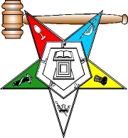
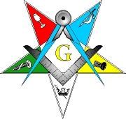
ORDER OF THE EASTERN STARS
The Order of Eastern Star has a spiritual appeal.
All lessons are based on Biblical history.
From our five pointed star we derive fidelity, constancy, loyalty, faith, and love.
Notes:
The Order of Eastern Star has a spiritual appeal that will always continue.
It is more than a sisterhood or brotherhood, more than a system of ritualism, or a field for social enjoyment.
All lessons are based on Biblical history and are for the betterment and enlightenment of humanity.
From our five pointed star we derive fidelity, constancy, loyalty, faith, and love bound together with patience, hope and charity.
Are there any questions?

Slide 4
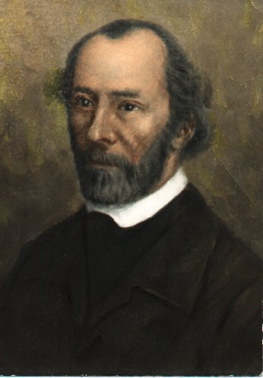
ORIGIN AND GENERAL HISTORY OF THE ADOPTIVE RITE
The Order of the Eastern Star is an adoptive rite of Freemasonry with teachings based on the Bible
The founder of OES was Dr. Robert Morris
The first Grand Chapter was organized in Michigan in 1867.
Notes:
The Order of the Eastern Star is an adoptive rite of Freemasonry with teachings based on the Bible and objectives that are charitable and benevolent.
The founder of OES was Dr. Robert Morris, a lawyer and educator from Boston, Massachusetts, who was a Master Mason and Past Grand Master of Kentucky.
After his first published ritual in 1849-50, he became associated with Robert Macoy who wrote and published a ritual based on Morris' in 1867.
The first Grand Chapter was organized in Michigan in the same year.
Are there any questions?

Slide 5
ORIGIN AND GENERAL HISTORY OF THE ADOPTIVE RITE cont.
Members must be eighteen years or older and either Master Masons in good standing or properly related to a Master Mason in good standing.
The latter category includes wives; widows; sisters; daughters; mothers; granddaughters; step-mothers; step daughters; step-sisters; and half-sisters.
Each chapter has eighteen officers, some elected and others appointed. Two offices are specifically male (Patron and Associate Patron) while nine offices are specifically female (including Matron and Associate Matron).
Notes:
In order to Join the Order a members must be eighteen years or older and either Master Masons in good standing or properly related to a Master Mason in good standing.
The latter category includes wives; widows; sisters; daughters; mothers; granddaughters; step-mothers; step daughters; step-sisters; and half-sisters. In 1994 this was expanded to include nieces, daughters-in- law, and grandmothers.
Each chapter has eighteen officers, some elected and others appointed. Two offices are specifically male (Patron and Associate Patron) while nine offices are specifically female (including Matron and Associate Matron).
While the Worthy Matron is considered to be the presiding officer of the chapter, the degrees cannot be conferred without a presiding brother in good standing (hence the Patron and Associate Patron).
What are the additional 7 offices are specifically for females

Slide 6
ORIGIN AND GENERAL HISTORY OF THE ADOPTIVE RITE cont.
Each chapter retains the right to decide who shall be a member of the organization.
The successful candidate must profess a belief in a Supreme Being
Initiated in five degrees, which are conferred in one ceremony.
Notes:
Each chapter retains the right to decide who shall be a member of the organization. Election to the degrees must be unanimous, without debate, and secret.
The successful candidate must profess a belief in a Supreme Being and is initiated in five degrees, which are conferred in one ceremony.
When Eastern Star was created, it was intended to be the first of a three degree series. The second and third degrees were Queen of the South and the Order of the Amaranth, respectively.
Interestingly enough, OES requires only the belief in a Supreme Being even though the degrees are based in both the Old and New Testaments.
While non-Christians are not specifically barred from membership, it would seem to be difficult to be other than Christian and belong to the Order.
Are there any questions?

Slide 7
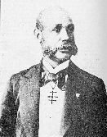
ORIGIN AND HISTORY OF THE ADOPTIVE RITE AMONG BLACK WOMEN.
Thornton Andrew Jackson received the several degrees of the Rite of Adoption of the Order of the Eastern Star from Brother C.B. Case
On December 1, 1874, Queen Esther Chapter No. 1, Order of the Eastern Star, was established
On April 28, 1890, Queen of Sheba Chapter No. 3 and on October 20, 1890, Gethsemane Chapter No. 4, Order of the Eastern Star was established
Notes:
On August 10, 1874, Thornton Andrew Jackson received the several degrees of the Rite of Adoption of the Order of the Eastern Star from Brother C.B. Case, a Deputy and agent of Illustrious Robert MaCoy 33°, Supreme Patron of the Rite of Adoption of the World. In addition, Thornton Jackson also received a letter from Bro. C. B. Case, granting him the authority to establish chapters of the Eastern Star among eligible black women. In obedience to the authority granted by William H. Myers, Grand Master, Union Grand Lodge, Jurisdiction of the District of Columbia, Bro. Jackson established the first Eastern Star Chapter among black women in the United States.
On December 1, 1874, Queen Esther Chapter No. 1, Order of the Eastern Star, was established at 708 O Street, N.W., Washington, D.C. in the home of Mrs. Georgiana Thomas. The first Worthy Matron was Sister Martha Welch and the first Worthy Patron was Bro. Thornton A. Jackson. He was also instrumental and helped to establish one (1) chapter in Alexandria, Virginia, three (3) chapters in Maryland and three chapters in Pennsylvania. In each instance when a chapter was organized and established, and was adopted by a regularly constituted Masonic Lodge.
During the year 1875, Pythagoras Lodge No. 9 presented the officers of Queen Esther Chapter No. 1 with their first badges, which were known as Rosettes. This presentation was made by Worthy Patron Thornton A. Jackson who wished the chapter success and prosperity in the work upon which they were entering. He admonished the officers to wear the Rosettes with dignity keeping ever before them the memory of the five(5) Heroines: Adah, Ruth, Esther, Martha and Electa.

Slide 8
FIVE HEROINES
ADAH-HONOR
RUTH-FELLOWSHIP
ESTHER-COURAGE
MARTHA-FAITH
ELECTA-LOVE
Notes:
The five points of this Star to each Sister/Brother doth reveal Fidelity, Patience, Purity, Faith and Zeal
Each Sister/Brother of this Order shall reflect the rays of light that Joy and Truth shall beam sincere from the darkness of the night
Each Sister/Brother should try their best to practice the virtues amplified by the Five Heroines, those virtues are as follows: Which is attribute do you favor more and why?
ADAH-HONOR. Be willing to sacrifice: in order to save each others honor. To fail to carry out a
commitment is the firsts step toward self-destruction.
RUTH-FELLOWSHIP. The value of a true friend far exceeds any materialistic value upon the face of this earth. A true friend will go the last mile of the way with you, as Ruth did with Naomi.
ESTHER-COURAGE. Be willing to defend and support each other for a worthy cause. Together we stand, divided we shall fall.
MARTHA-FAITH. Without faith, there is not hope for a better day. Faith is essential for spiritual survival and if the spirit is weak or dead, so is the body.
ELECTA-LOVE. Love binds our hearts in fellowship. Love is the one element that will sustain the Masonic family through the trials and tribulations of this earthly life. In order for us to be at the final gathering of those dressed in white, love must be the STAR in the EAST, that we have come to worship.

Slide 9
DEGREES OF THE ORDER
The Five (5) degrees of the OES are founded on the Holy
Scriptures.
ELECTA ADAH
MARTHA RUTH
ESTHER
Mother
Daughter
Sister
Widow
Wife
Notes:
The Five (5) degrees of the OES are founded on the Holy Scriptures. Five worthy and potable female characters, illustrating many moral virtues. Can anyone state the relationship of the first, second, third, fourth, and fifth star point. Allow someone to state the relationship before you give the meaning.
ADAH - the daughter degree, illustrating integrity filial devotion and respect to the binding force of a vow.
RUTH - the widow degree, illustrating industry, loyalty and devotion to religious principles.
ESTHER - the wife degree, illustrating justice, courage and fidelity to kindred and friends.
MARTHA - the sister degree, illustrating undeviating faith in the hour of trail and the immorality of the real soul.
ELECTA - the mother degree, illustrating feverency, love, generosity, patience and submission under wrongs.

Slide 10
BIBLE REFERENCES
ADAH JEPHTHAH'S DAUGHTER.**** Judges, 11:35.
The name Adah means "adornment" and appears
several times in the Old Testament, but we are
interested in this connection with the daughter
of Jephthah who bore this name.
This incident in Biblical history is used by the Eastern
Star to symbolize the binding and serious nature of a
vow.
Notes:
The name Adah means "adornment" and appears several times in the Old Testament, but we are interested in this connection with the daughter of Jephthah who bore this name.
Jephthah, an important judge and military personage in the Old Testament, took an oath or vow before going out on an important military mission that he would sacrifice the first thing he would see coming from his house if he returned victorious.
He was the victor of the campaign and on his return Adah, his only child, was the first thing that came from his house to see him.
The broken-hearted Jephthah was loyal to his vow, though he protested against this custom.
This incident in Biblical history is used by the Eastern Star to symbolize the binding and serious nature of a vow.

Slide 11
BIBLE REFERENCES
RUTH. **** Ruth, 2. 5.
The name Ruth means "companion." The story of
Ruth is the most beautiful story in the Holy Bible
This story is used by the Eastern Star to symbolize
constant faithfulness to one's duty.
Notes:
The name Ruth means "companion." The story of Ruth is the most beautiful story in the Holy Bible, Ruth was a native of Moab.
She was married, but an epidemic killed the men of the community, including her husband. In accordance with custom, she returned to Bethlehem where she lived with her mother-in-law, Naomi.
Times were hard and they secured employment from Boaz, a kinsmen of her dead husband. Boaz also was her protector.
He was attracted to her primarily because of her devotion and loyalty to Naomi. He married her and they had a child to whom they gave the name of Obed who became the grandfather of David.
This story is used by the Eastern Star to symbolize constant faithfulness to one's duty.

Slide 12
BIBLE REFERENCES
ESTHER **** Esther, 5. 3.
The name Esther means "star.
This story is used by the Eastern Star to Symbolize one's
fidelity to kindred and friends.
Notes:
The name Esther means "star." In the Holy Bible Esther is presented as a person of great strength and personal beauty who heard of a plot against her people and protected them from destruction.
The plotter was hanged in their stead. This story is used by the Eastern Star to symbolize one's fidelity to kindred and friends.

Slide 13
BIBLE REFERENCES
MARTHA, **** John, 11. 26.
The name Martha means "lady.“
The Eastern Star uses this story to symbolize
enduring faith and a belief in eternal life.
Notes:
The name Martha means "lady." The name appears a number of times in the New Testament, and Biblical scholars are not too sure that the name is used each time relating to the same person.
The Eastern Star uses the name in its ritual in connection with the sister of Mary and Lazarus, of Bethany, who was a close friend of Jesus. It was Lazarus who was raised from the dead.
The Eastern Star uses this story to symbolize enduring faith and a belief in eternal life.

Slide 14
BIBLE REFERENCES
ELECTA, **** John, 11. 26.
The name Electa is not easily attached to a specific
person. In the Second Epistle of John, a lady
mentioned therein is described as an "elect lady.“
The Eastern Star uses this part of the Holy Bible to
symbolize patience and peaceful submission to
persecution for one's belief in God.
Notes:
The name Electa is not easily attached to a specific person. In the Second Epistle of John, a lady mentioned therein is described as an "elect lady."
Tradition informs us that she was an ardent Christian who devoted all her time and effort to promoting Christianity in a day when this was unpopular and also dangerous.
As a result of her activities, she was put to death and thus became a martyr. This was her wish so that her life work might testify to the enduring strength of Christian love.
The Eastern Star uses this part of the Holy Bible to symbolize patience and peaceful submission to persecution for one's belief in God.

Slide 15
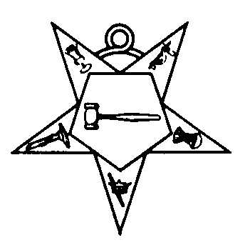
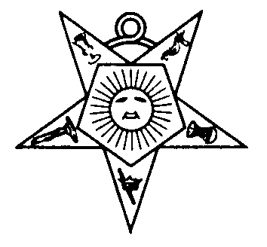
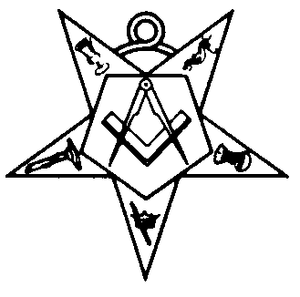
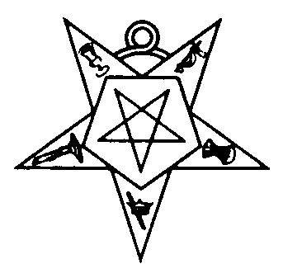
SYMBOLS OF THE EASTER STAR
The three officers, Worthy Matron, Worthy
Patron and Associate Matron make up a trinity
that combines wisdom, strength and love. The
Associate Patron adds strength to all.
Notes:
Briefly I will relate the symbols of this great order to lessons which can be carried with us each day. Here are a few symbols in relations to Eastern Star and they are as follows

Slide 16
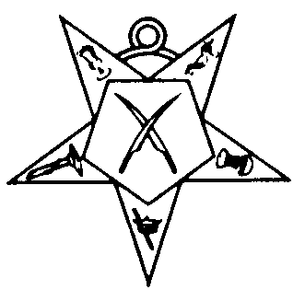
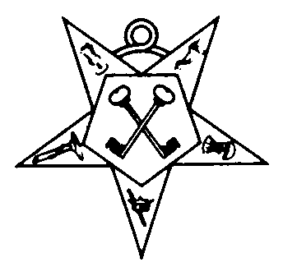
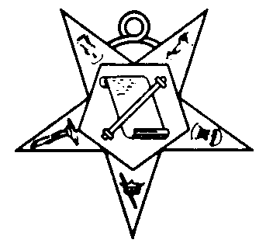
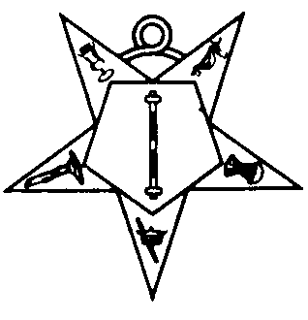
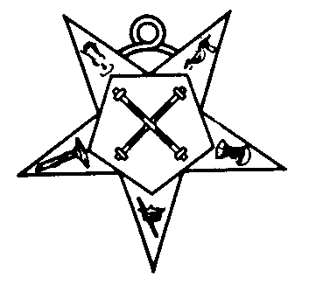
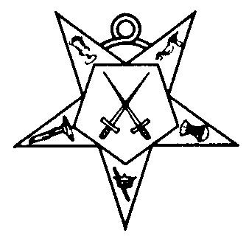
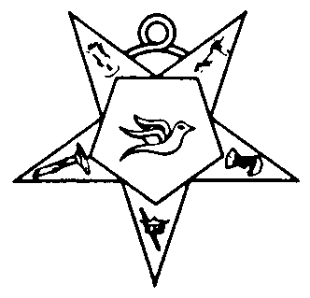
SYMBOLS OF THE EASTER STAR
The SECRETARY, with the CROSSED PINS
The TREASURER, with the KEYS,
The CONDUCTRESS, with her SCROLL and BATON
The ASSOCIATE CONDUCTRESS, with her BATON
The MARSHALL, with the CROSSED BATONS
The SENTINEL, with the CROSSED SWORDS
The WARDER, wears the Dove of peace
Notes:
The Secretary, with her CROSSED PINS, would indicate that two pens are used. One a pen of COMMENDATION, the other one CONDEMNATION, representing that our deeds may be recorded as either being good or bad.
The Treasurer, with her KEYS, emblems of security, needed to conserve the funds necessary to conduct the business of the order.
The CONDUCTRESS, with her SCRO|LL and BATON, teaches that there must be plans if there is to be success.
The ASSOCIATE CONDUCTRESS, with her BATON, represents discipline. We must all move in harmony if we mean to accomplish much. It is everlasting teamwork that has enabled the world to progress.
The MARSHALL, with her CROSSED BATONS, is the one who teaches us that he who loves best, serves best.
The SENTINEL, with the CROSSED SWORDS, represents protection and justice, that no one enters the chapter room with unclean thoughts and that when we leave, all transactions are secret and shall forever be locked within.
The WARDER, wears the Dove of peace, a symbol of harmony. While we have opinions and can express them, let us not forget that others have the same privilege.

Slide 17
NUMBERS 3-5-7
THREE
The Order of the Eastern Star is dedicated to three things.
Each sign is given in THREE distinct motions.
Without THREE distinct primary elements there is no life for our being is composed of BODY, MIND and SOUL.
There are THREE great events in a person’s life
The grip is given with THREE distinct movements.
CHARITY, TRUTH and LOVING KINDNESS.
Birth, Life and Death.
Notes:
In all the Eastern Star work we find that numbers are used to convey certain ideas, or plans.
Can someone tell me what three things is the Order of the Eastern Star dedicated to.
Can someone tell me what three great events are part of a person’s life.

Slide 18
NUMBERS 3-5-7
THREE cont.
Jesus was persecuted THREE days.
Jesus was scorned times THREE.
Jesus was mocked THREE times; the robe, the crown and the reed.
Jesus lay THREE days in the tomb.
Jesus rose on the THIRD day.
There are THREE words in each of the passes.

Slide 19
NUMBERS 3-5-7
FIVE
There are FIVE raps at the door.
There are FIVE points to the Star.
There are FIVE emblematic colors.
There are FIVE emblems and FIVE symbols.
There are FIVE letters in the cabalistic word.
Notes:
Can someone name the letters in the cabalist word.
Can someone tell me what are the five emblems and five symbols.

Slide 20
NUMBERS 3-5-7
FIVE cont.
There are FIVE words in the cabalistic motto.
There are FIVE signs and FIVE degrees.
There are FIVE divisions of the Eastern Star Degrees.
There are FIVE degrees of relationship of women to a Master Mason.
Notes:
Can someone give the five words in the cabalistic motto

Slide 21
NUMBERS 3-5-7
SEVEN
There are SEVEN ties to the obligation.
SEVEN officers give instructions.
SEVEN members constitute a quorum.
Candidates are presented to SEVEN stations.
SEVEN assumes in the Bible a great significance, generally indicating completion or perfection.
Notes:
Can anyone tell me what seven stations are the candidates present to during initiation.

Slide 22
Worthy Matron
Directs all Activities of the Chapter
Treasurer
Financial Matters
Financial Reports
Special Activities
Secretary /Asst. Sec
Record Proceedings
Report to Grand Chapter
Typing as Required
Ordering Forms and Supplies
Sponsorship Letters
Associate Matron
Ways and Means
Budget and Finance
Sickness and Distress
Love Token Plaques
Past Matron/Past Patron Regalia
Worthy Patron
Constitutions and By Laws Research
Resolutions
Publicity
Fraternal Relations
Degree Work
Conductress
OES Floor Work
Newsletters
Info to members Abroad
Musician
Chapter Music
Youth Activities
Get acquainted with proposed members
Associate Conductress
Ritualistic Work
Inactive OES Members
Investigations
Associate Patron
Public Relations
Historian
Audit Chairman
Chaplain
Chairman for Charity
Photos
Scrapbook
Chairman of
Trustee
Scholarship
Investments
Paraphernalia needs
Inventory
Star Points
Art Project
Queen Contest
Chapter Entertainment
Marshalls
Hail and Farewells
Birthdays
Mentors
Flag Bearers
Assistance
Sentinel
Security
Locations for OES Activities
Warder
Assist the Sentinel
Trustees
Assist the Chairman of Trustee
Notes:
Here we have a chart with suggestive ways to utilize your member and to keep them involved. Again this is just a sample that may be useful to you as you conduct your daily functions within the Chapter.

Slide 23
WORDS TO LIVE BY!
People are often unreasonable, illogical and self-centered
FORGIVE them anyway.
If you are kind, people may accuse you of selfish ulterior motives
Be KIND anyway.
If you are successful, you will win some false friends and some true enemies
SUCCEED anyway.
If you are honest and frank, people may cheat you
Be HONEST and FRANK anyway.
Notes:
People are often unreasonable, illogical and self-centered
FORGIVE them anyway.
If you are kind, people may accuse you of selfish ulterior motives
Be KIND anyway.
If you are successful, you will win some false friends and some true enemies
SUCCEED anyway.
If you are honest and frank, people may cheat you
Be HONEST and FRANK anyway.
What you spend years building, someone could destroy overnight
BUILD anyway.

Slide 24
WORDS TO LIVE BY! cont.
What you spend years building, someone could destroy overnight
BUILD anyway.
If you find serenity and happiness, they may be jealous
Be HAPPY anyway.
The good you do today, people will often forget tomorrow
Do GOOD anyway.
Give the world the best you have and it may never be enough
Give the world the BEST you got anyway.
Notes:
If you find serenity and happiness, they may be jealous
Be HAPPY anyway.
The good you do today, people will often forget tomorrow
Do GOOD anyway.
Give the world the best you have and it may never be enough
Give the world the BEST you got anyway.
You see, in the final analysis, it is between you and GOD
It was NEVER between you and them anyway.

Slide 25
You see, in the final analysis, it is between you and GOD
It was NEVER between you and them anyway.

Slide 26
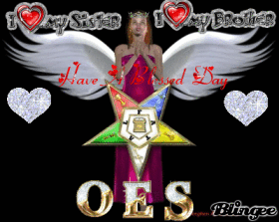
????? QUESTIONS ????
“You can’t Keep a Star from Shinning”
Notes:
Are there any questions at this time.

